Slide 1



PAGE 1
2BZ Presentation
Benedict, Bryan, Zhi Kai

Slide 2

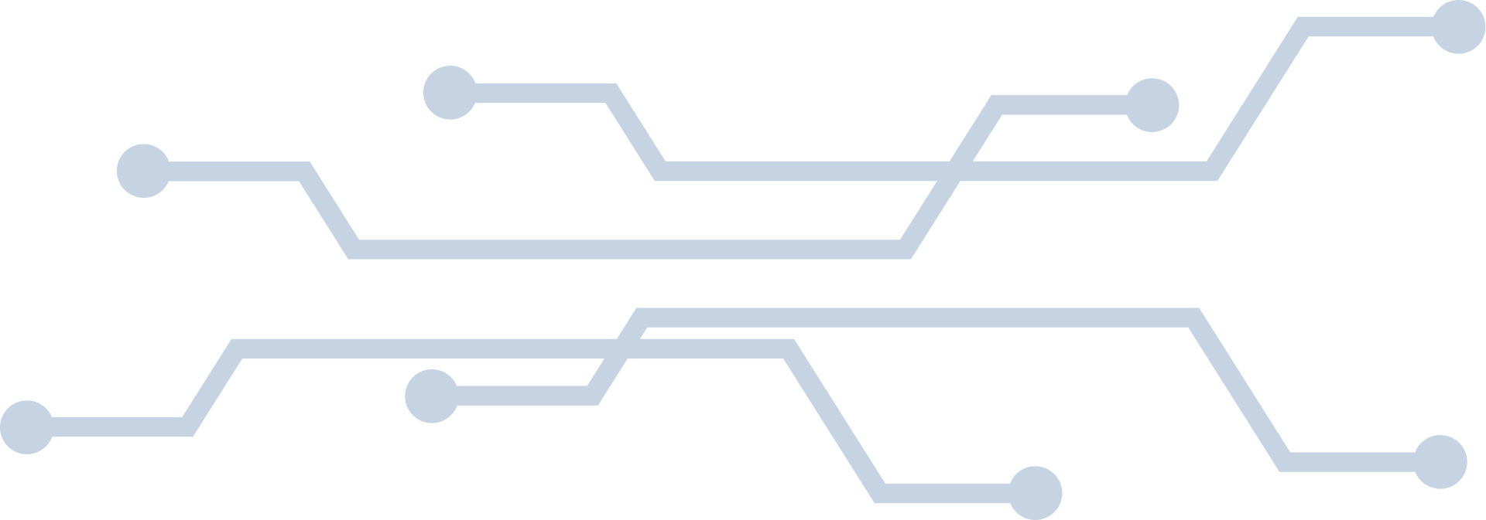

PAGE 2
Problem
Websites that include features with high overheads are prone to Dos/DDoS-ing. As such, we aim to reduce such occurrences by disconnecting malicious actors who managed to bypass primary bot detectors.

Slide 3
PAGE 3
How?
Keep track of some user metrics while they are on the website
Average cursor speed
Average cursor accuracy (how close the user clicked was to the centre of the button)
Time To First Action (TTFA)
Store these metrics in a hash table by user, which will be cleared periodically
Most recent entries within 1 hour will be kept
During times of high traffic, program will boot up
Tabulates the statistics of all users for each metric and forms a trend and standard deviation from it
If SD is sufficiently small, users with metrics found to be of a similar trend will be flagged as potential bots and disconnected from the web
Not a standalone solution to identify malicious actors
To be used in conjunction with other known methods to combat botting

Slide 4
PAGE 4
Demo

Slide 5
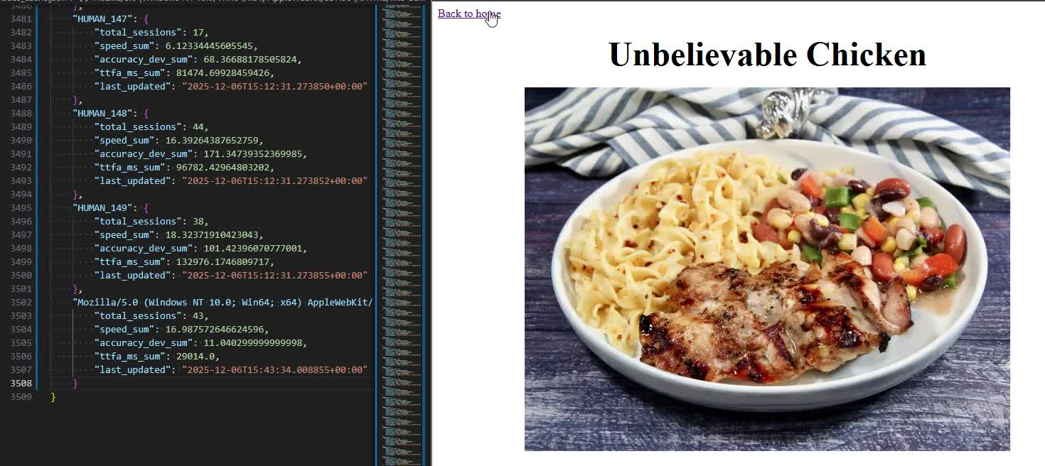
PAGE 4

Slide 6
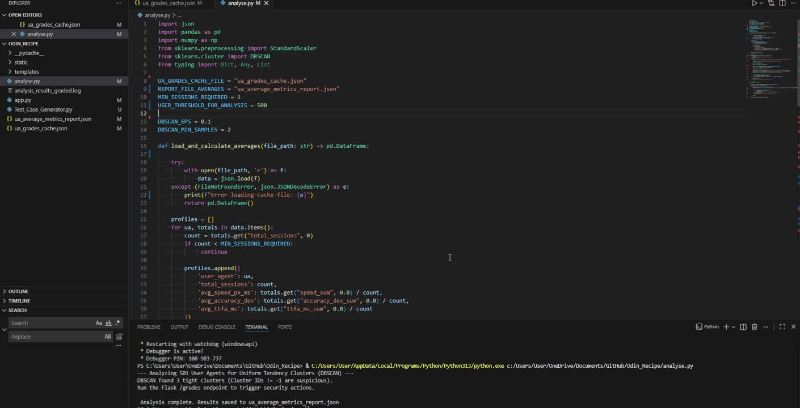
PAGE 4

Slide 7
PAGE 5
Limitations
Metrics currently used may not be sufficient to determine whether the user is actually not a human
A user could happen to fall within the SD by chance and get kicked
More metrics could increase the likelihood that a user who falls within the SD is a bot
Determination of how sufficiently small SD should be is subjective
Too small, and more bots will be let through
Too big, and real users are more likely to be kicked
More research is required to accurately determine the value of SD for each metric
Effective if website has many possible actions
Websites with few possible actions are hard to detect anomalous behaviour from
May result in many false positives
Not suggested to implement on such websites

Slide 8
PAGE 6
Thank you :)

